Slide 1
Web based Programming
5. JavaScript and HTML

Slide 2
5.1 JavaScript Execution Environment
The JavaScript Window object represents the window in which the browser displays documents
  The properties of the Window object are visible to all JavaScript scripts in the window’s HTML document
  All global variables are properties of Window
  document – a reference to the Document object representing the HTML document that the window displays
The Document Object Model (DOM) defines the interface between HTML documents and application programs – an application programming interface (API)
  It is an abstract model because it applies to a variety of application programming languages

Slide 3
5.2 The Document Object Model (1)
A language that supports the DOM must have a binding to the DOM constructs
  A correspondence between constructs in the language and elements in the DOM
  In the JavaScript binding
  elements => objects
  element attributes => properties
  e.g. <input type = "text" name = "address">
  an object with two properties, type and name, with the values "text" and "address" respectively

Slide 4
5.2 The Document Object Model (2)
Documents in the DOM have a treelike structure
<html xmlns = “…”>
<head>
<title> A simple document </title>
</head>
<body>
<table>
<tr>
<th> Breakfast </th>
<td> 0 </td>
<td> 1 </td>
</tr>
<tr>
<th> Lunch </th>
<td> 1 </td>
<td> 0 </td>
</tr>
</table>
</body>
</html>
Document
<head>
<body>
<table>
<title>
<tr>
<tr>
“A simple
document”
<th>
<td>
<td>
<th>
<td>
<td>
“Break
fast”
“0”
“1”
“Lunch”
“0”
“1”

Slide 5
5.3 Element Access in JavaScript (1)
The elements of an HTML document have corresponding objects that are visible to an embedded JavaScript script
Every Document object has:
  forms – an array of references to the forms in the document
    Each forms array element has an elements array as a property, which has references to the form’s elements
  Document also has property arrays referring to anchors, links and images

Slide 6
5.3 Element Access in JavaScript (2)
Several ways to access the form elements
  Example (a document with just one form and one widget):
  <form action = "">
  <input type = "button" name = "pushMe">
  </form>
  DOM address – the address of the JavaScript object that is associated with an XHTML element
  document.forms[0].elements[0]
  Problem: document changes

Slide 7
5.3 Element Access in JavaScript (2)
Several ways to access the form elements
  Example (a document with just one form and one widget):
  <form action = "">
  <input type = "button" name = "pushMe">
  </form>
  Element names – this requires the element and all of its ancestors (except body) to have name attributes
  <form name = "myForm" action = "">
  <input type = "button" name = "pushMe">
  </form>
  document.myForm.pushMe
  Problem: error prone and inefficient for deeply nested elements

Slide 8
5.3 Element Access in JavaScript (2)
Several ways to access the form elements
  Example (a document with just one form and one widget):
  <form action = "">
  <input type = "button" name = "pushMe">
  </form>
  getElementById Method
  document.getElementById("pushMe")
  Because an element’s identifier (id) is unique in the document, this approach works, regardless of how deeply the element is nested in other elements in the document

Slide 9


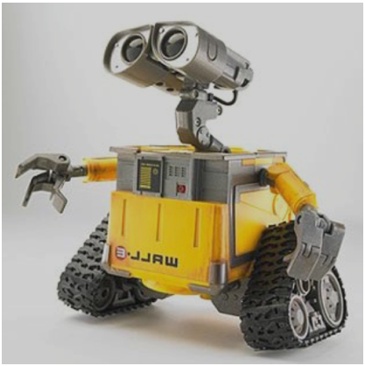

5.3 Element Access in JavaScript (2)
  document.forms[0].elements[0]
  document.myForm.pushMe
  getElementById("pushMe")

Slide 10
5.3 Element Access in JavaScript (3)
  Checkbox and radio button groups have an implicit array – the same name as the group name
  <form id = "topGroup">
  <input type = "checkbox" name = "toppings" value = "olives" />
  ...
  <input type = "checkbox" name = "toppings" value = "chillis" />
  </form>
  var numChecked = 0;
  var dom = document.getElementById("topGroup");
  for (index = 0; index < dom.toppings.length; index++)
  if (dom.toppings[index].checked)
  numChecked++; // count the number of checkboxes checked

Slide 11
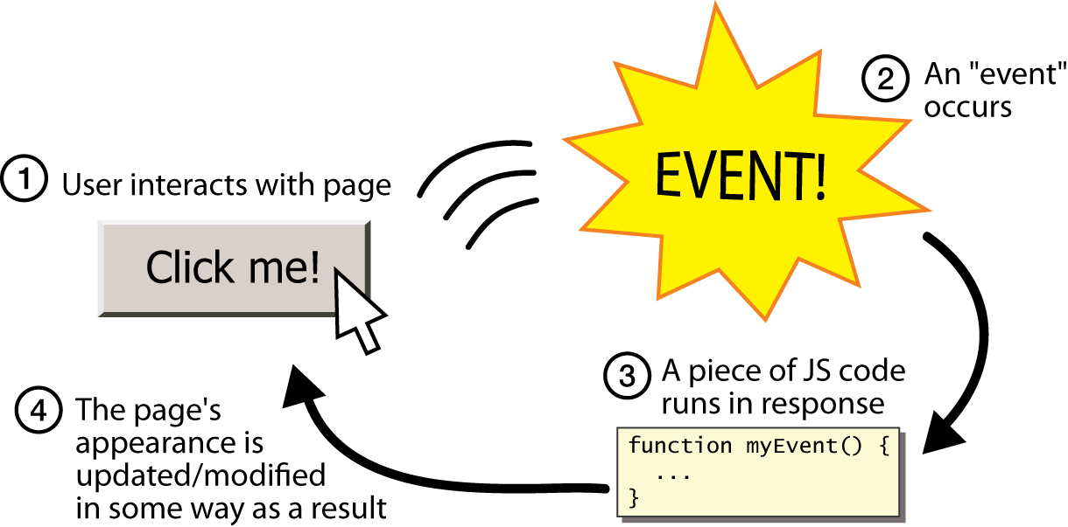
5.4 Events and Event Handling (1)
An important JavaScript usage for web programming is to detect certain activities of browser/user and provide computation when these activities occur – event-driven programming

Slide 12
5.4 Events and Event Handling (1)
An important JavaScript usage for web programming is to detect certain activities of browser/user and provide computation when these activities occur – event-driven programming
An event is a notification that something specific has occurred, either with the browser or an action of the user
  e.g. the completion of loading a document
  e.g. a mouse click on a form button
  Events are JavaScript objects, e.g. click
An event handler is a script that is implicitly executed in response to the appearance of an event

Slide 13
5.4 Events and Event Handling (2)
The process of connecting an event handler to an event is called registration
Event handlers can be registered in the following ways:
  First way: by assigning the event handler script to an event tag attribute of an HTML element
  <input type = "button" id = "myButton" onclick = "alert('clicked');">
  <input type = "button" id = "myButton" onclick = "myHandler();">
Example5-2.html

Slide 14
5.4 Events and Event Handling (3)
  Commonly used events and their associated tag attributes
  The same attribute can appear in several different tags
  e.g. the onclick attribute can be in <a> and <input>
Event | Tag Attribute | Event | Tag Attribute
blur | onblur | change | onchange
click | onclick | focus | onfocus
load | onload | mousedown | onmousedown
mousemove | onmousemove | mouseout | onmouseout
mouseover | onmouseover | mouseup | onmouseup
select | onselect | submit | onsubmit
unload | onunload

Slide 15
5.4 Events and Event Handling (4)
Event handlers can be registered in the following ways:
  Second way: by assigning the event handler to a property of the JavaScript object associated with the HTML element
  document.getElementById("myButton").onclick = myHandler;
  The registration must follow both the handler function and the HTML form specification so that JavaScript has seen both before assigning the property
  Only the name of the handler function is assigned to the property – it is neither a string nor a call to the function

Slide 16

5.5 Handling Events from Button Elements (1)
Example – handling onclick event
Example5-2.html
  document.getElementById(“planebutton").onclick = planechoice;
  Example5-3.html

Slide 17
5.5 Handling Events from Button Elements (2)
  var dom = document.getElementById("myForm");
  for (var index = 0; index < dom.planeButton.length; index++) {
  if (dom.planeButton[index].checked) {
  plane = dom.planeButton[index].value;
  break;
  }
  }

Slide 18
5.5 Handling Events from Button Elements (3)
The disadvantage of specifying handlers by assigning them to event properties is that there is no way to use parameters
The advantages of specifying handlers by assigning them to event properties are:
  It is good to keep HTML and JavaScript separate
  The handler could be changed during use

Slide 19
5.6 Handling Events from Textbox Elements (1)
The Focus Event
  A text element gets focus in three ways:
    When the user puts the mouse cursor over it and presses the left mouse button
    When the user tabs to the element
    By executing the focus method
    When a text element has focus, any keyboard input goes into that element
  An element becomes blurred when:
    When the user moves the cursor away from the element and clicks the left mouse button
    When the user tabs away from the element
    Another element gets focus
  The Focus event can be used to detect illicit changes to a text box by blurring the element every time the element acquires focus (the blur method)
Example5-4.html

Slide 20
5.6 Handling Events from Textbox Elements (2)
Checking Form Input
  A good use of JavaScript, because it finds errors in form input before it is sent to the server for processing: onsubmit
  Things that must be done:
    Detect the error and produce an alert message (the alert method)
    Put the element in focus, which puts the cursor in the element (the focus method),
    e.g. document.getElementById("phone").focus();
    Select the element to highlight the text in it (the select method)
  To prevent the browser from performing the default action, the handler must return false
  Save both server time and Internet time

Slide 21
5.6 Handling Events from Textbox Elements (3)
Example – comparing passwords
Example5-5.html

Slide 22
5.6 Handling Events from Textbox Elements (4)
Another Example – checking the format of a name and phone number
  Example5-6.html

Slide 23
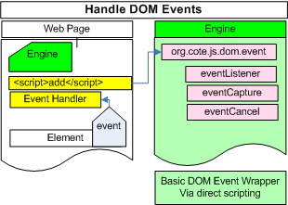
5.7 The part you did not see

Slide 24

5.7 The part you did not see

Slide 25


5.7 The part you did not see

Slide 26
5.7 The part you did not see
Don’t use document.write in an event handler
Events usually occur after the whole document is displayed, so if write appears in an event handler, the output may be placed over the existing document

